Slide 1
Department of Chemistry
TOPIC

Slide 2
Agenda
01
02
03
04
Department Profile
Highlights
Faculty Profile
Teaching, Learning and evaluation
05
06
07
08
Students Profile
Student Achievements
Staff Research Profile
Staff achievements
09
10
11
12
Outreach Programmes
Workshops and Webinars
Significant Events
Placements
13
14
15
16
Industrial Visits
Best Practices
SWOC Analysis
Future Plan

Slide 3
Department Profile
YEAR OF ESTABLISHMENT - 2010
Programme Offered : B.Sc Chemistry
Allied Paper : Chemistry I & II
NME Papers : Chemistry Of Consumer Products : Chemistry of Pollution, Food & cosmetics : Chemistry in day–to-day life

Slide 4
Highlights
1
Adequate and well-equipped laboratory
2
Linkages with Chemical local companies for internship and Industrial visit
3
Water testing services provided on demand
4
ICT-based teaching and learning for modelling Chemical structures

Slide 5
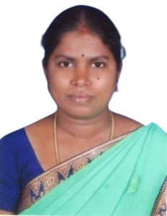
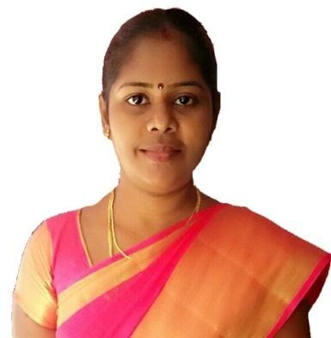
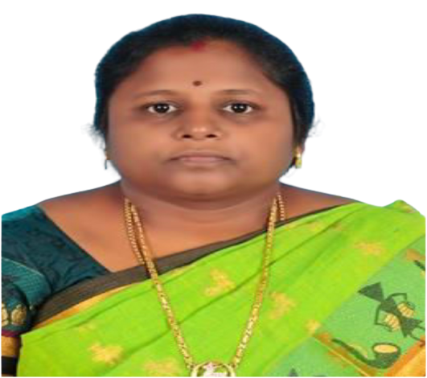
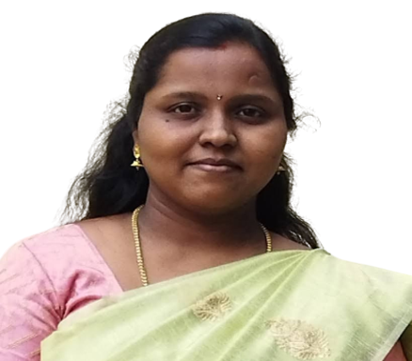
Faculty Profile
Dr.P.Lakshmi Prabha
M.Sc., B.Ed., M.Phil., Ph.D
S.Mercy Kiruba
M.Sc., B.Ed., M.Phil.
B. Sasi
M.Sc., M.Phil., PGDCA.,
Assistant Professor
Assistant Professor & Head
Assistant Professor
Dr.K.Rajalakshmi
M.Sc., B.Ed., M.Phil., Ph. D
Assistant Professor
Dr.L.Bhuvana
M.Sc.,B.Ed.,M.Phil., Ph.D
Assistant Professor

Slide 6
Teaching, Learning and Evaluation
Teaching Method
Learning Method
Evaluation Method
Chalk and Talk Method
Charts
Models and tools
Smart Board
Study Materials
Laboratory Manual
Question Bank
Reading E-books
Group discussion
Quiz
Seminars
Test
Assignment

Slide 7
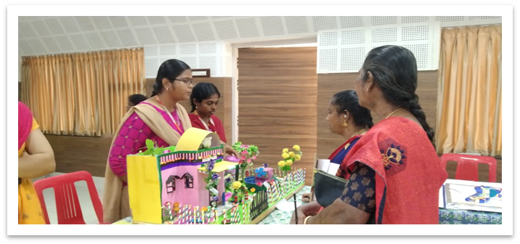
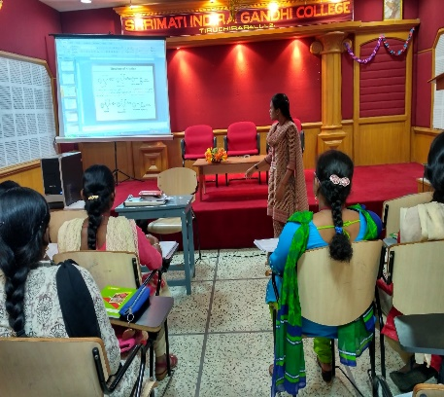
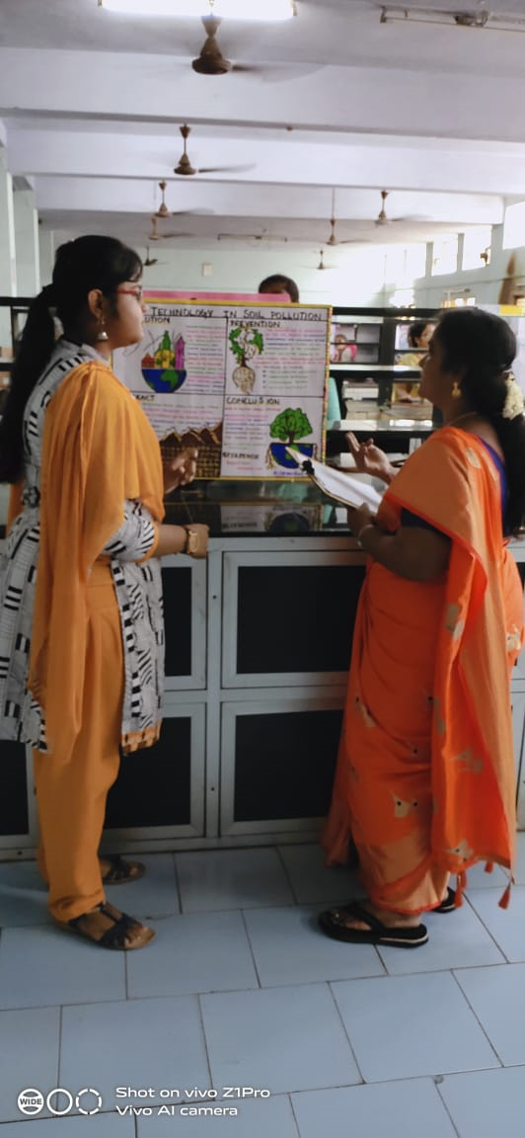
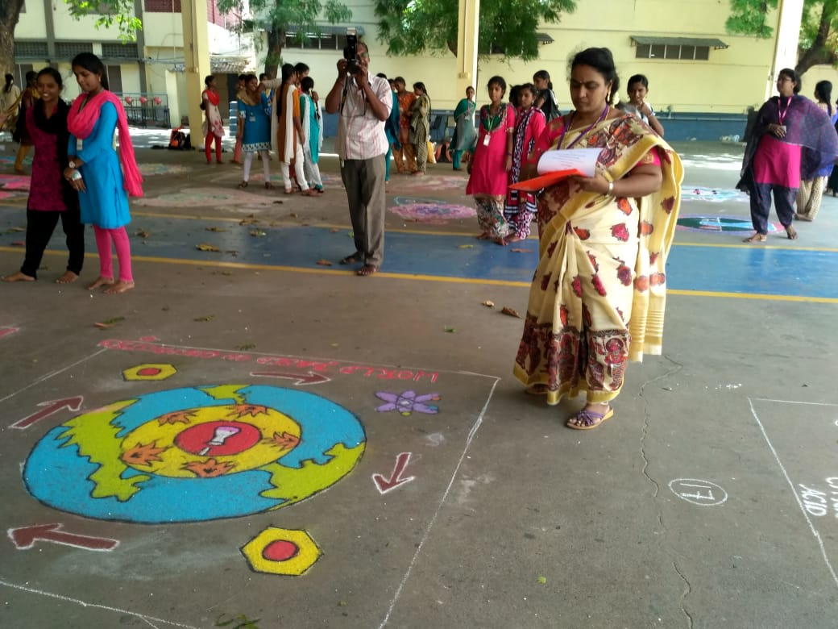
Students Profile
Student Centric Methods
Results
Rank holders
Year | Pass Percentage
2017-18 | 85
2018-19 | 97
2019-20 | 100
2020-21 | 100
2021-2022 | 97
Year | No of Rank holders
2017-18 | 4
2018-19 | 5
2019-20 | 5
2020-21 | 2
2021-22 | 4
Total | 20
Exhibition
Student seminar
No of students completed
Value Added Course - 10
Certificate Programme in Laboratory Techniques - 10
Diploma in Medical Lab Techniques - 10
Swayam Course (Basics in Inorganic Chemistry) - 03
Poster Presentation
Awareness Program

Slide 8
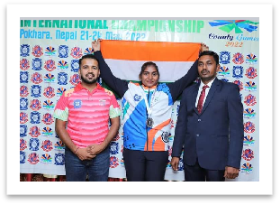
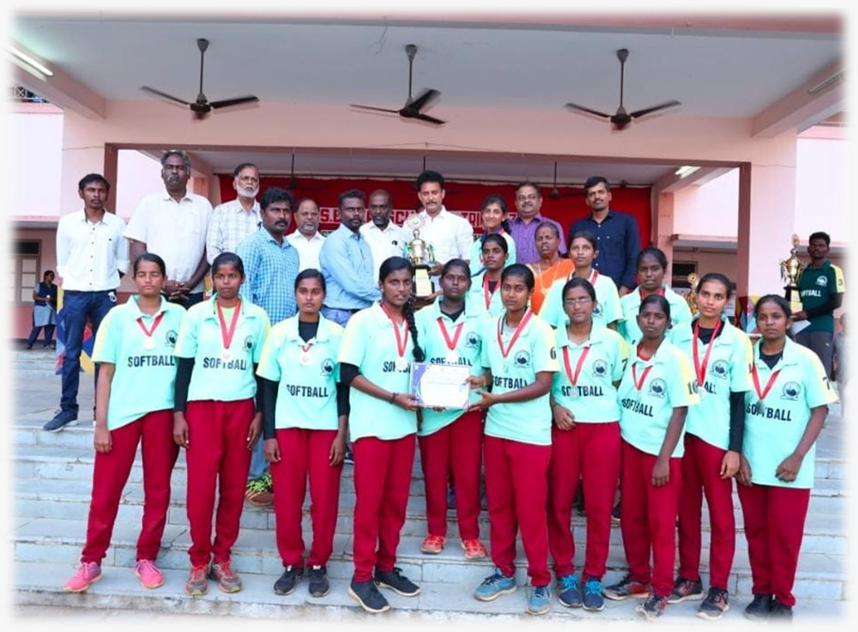
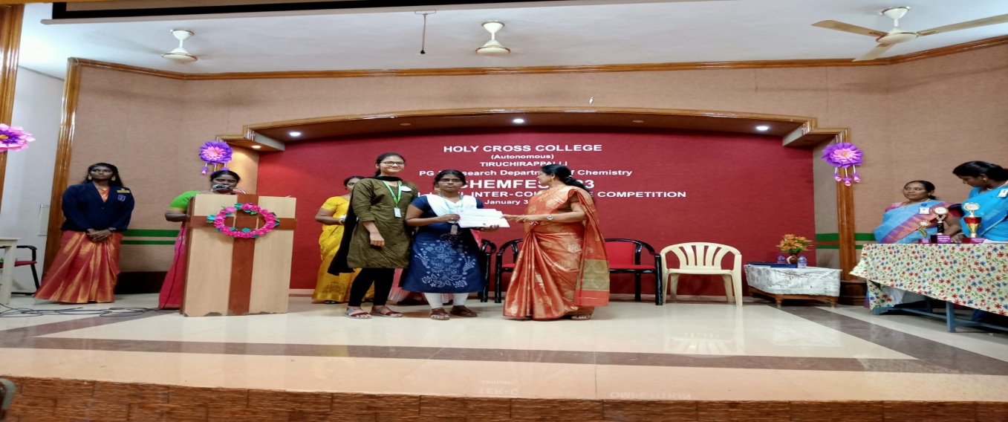
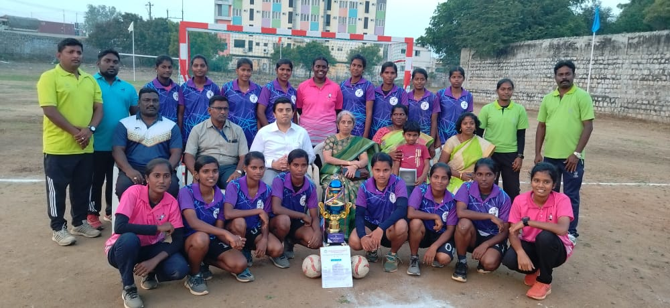
Students Achievements
INTERCOLLEGIATE SPORTS
AND TOURNAMENTS HAND BALL - WINNER
INDO NEPAL BADMINTON
CHAMPIONSHIP - SILVER MEDAL
No. of Awards
Sports : 5
Fine arts : 2
Literary events : 5
INTERCOLLEGIATE COMPETITION
CHEM CARTOONING - WINNER
SENIOR STATE SOFTBALL
CHAMPIONSHIP - RUNNER

Slide 9
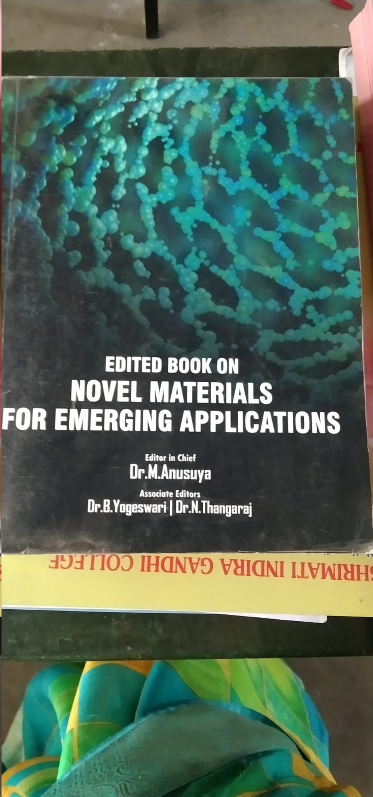
Staff Research Profile
Reviewer
Dr.P.Lakshmi Prabha – 1 Elsevier journal - Ultrasonics Sono Chemistry
Editor
Dr.L.Bhuvana - 6 International Journals
Total No of Publications For The Past Five Years : 10
Book / Book Chapters : 3
No of Conference Proceedings : 4

Slide 10
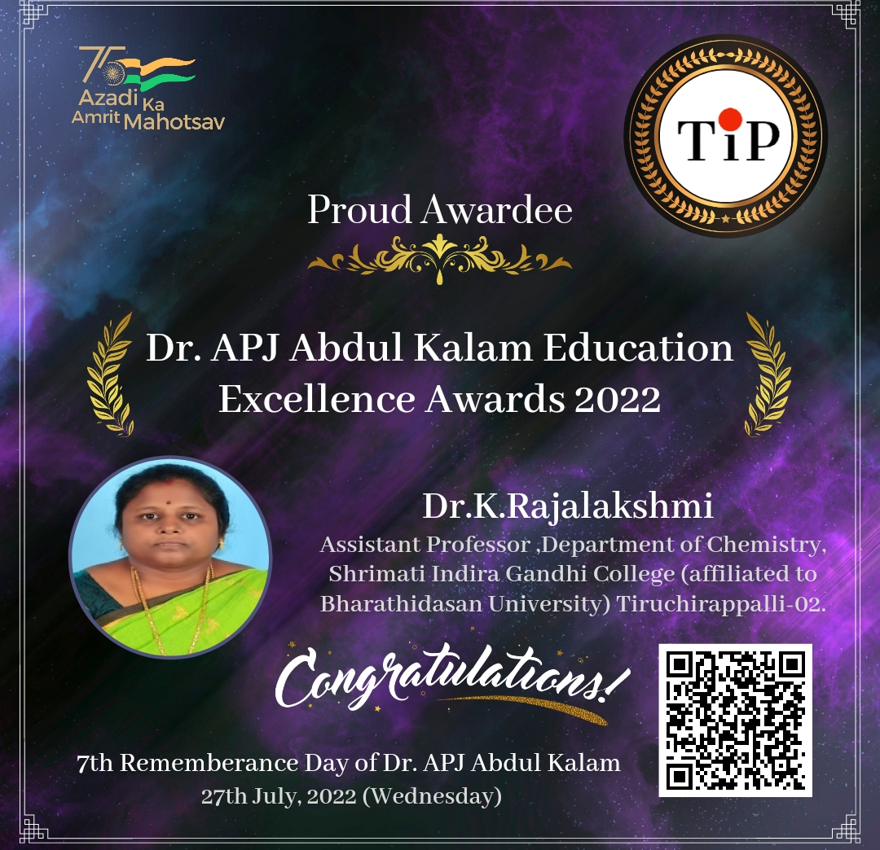
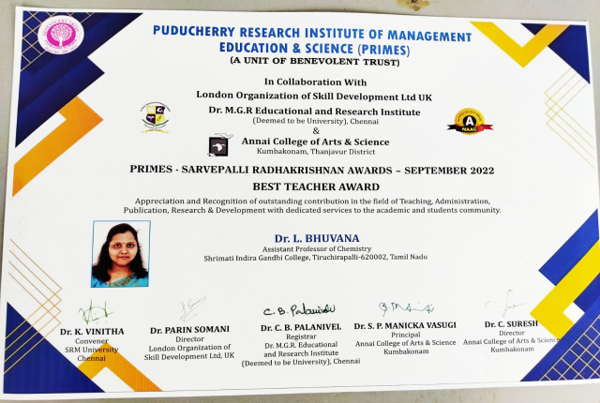
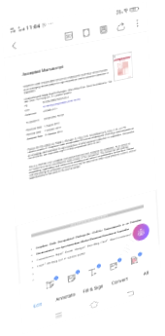
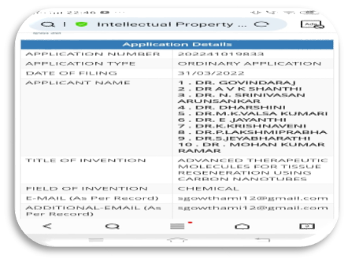
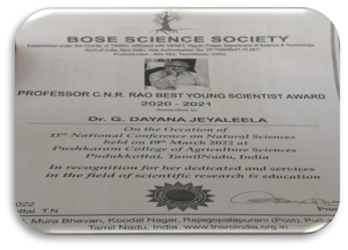
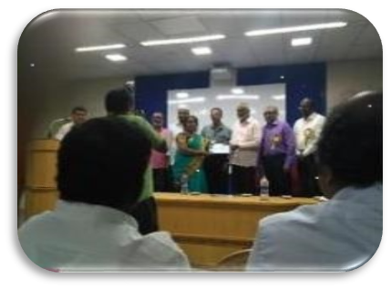
Staff Achievements
Abdul Kalam Education Award
Best Teacher Award
High Impact Factor
Patent Filed
Young Scientist Award
Best Paper Presentation Award

Slide 11
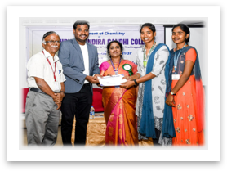
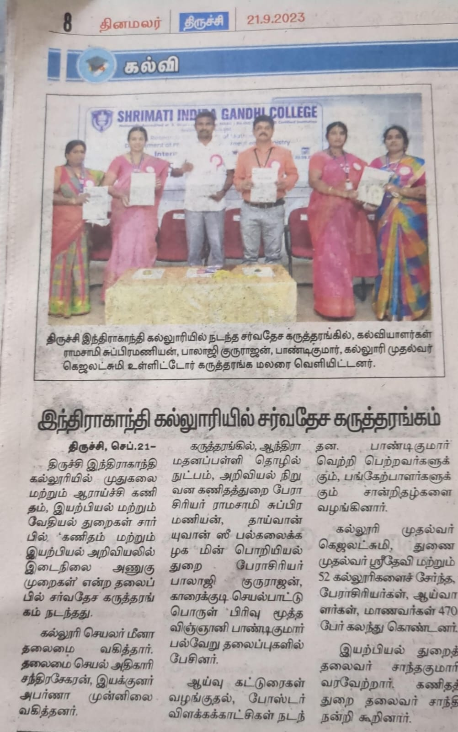
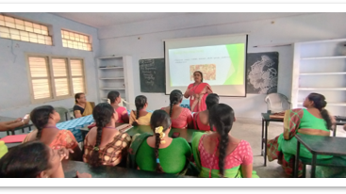
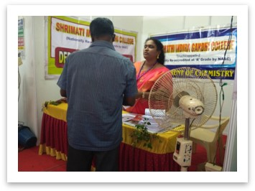
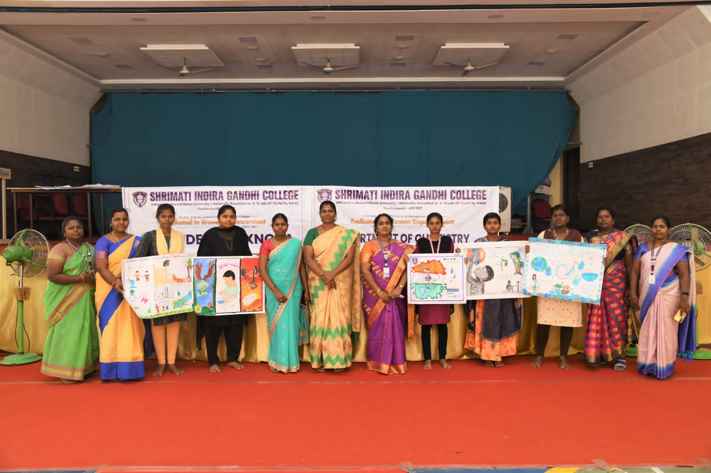
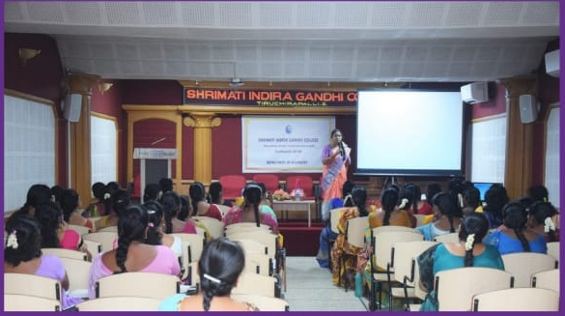
Significant Events
International conference
Faculty Development Program
International Seminar
Environmental Challenges in Industry
Interdisciplinary Approaches in Maths
and Physical Sciences
Healthy Food Practices for Working Women
Medical camp
World Water Day Celebration
Shape Yourself with Siddha

Slide 12
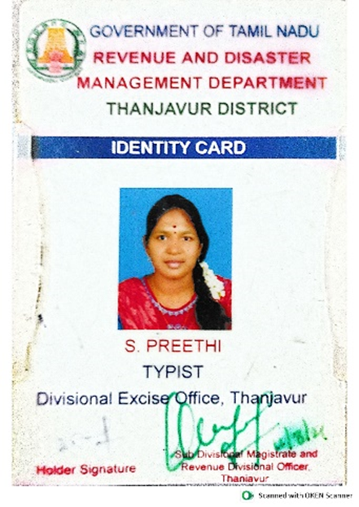
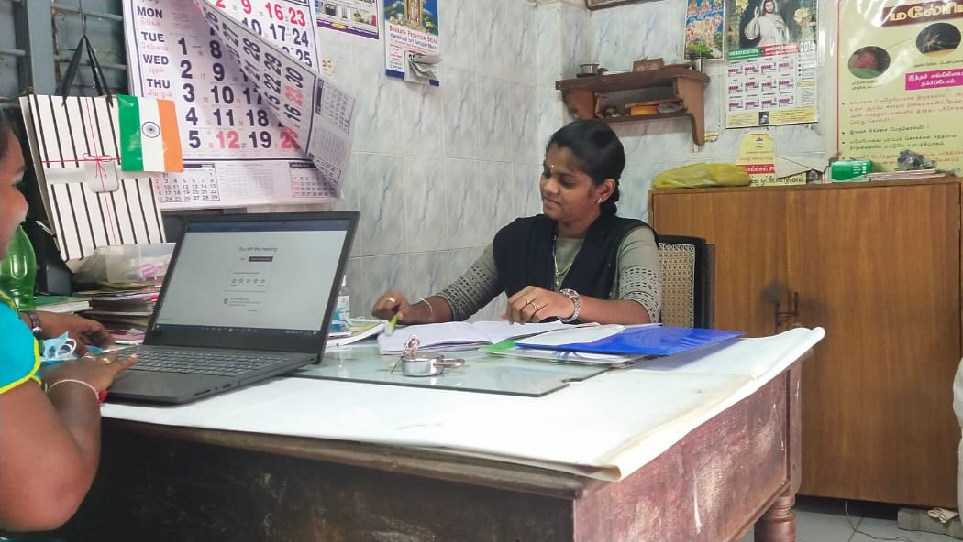
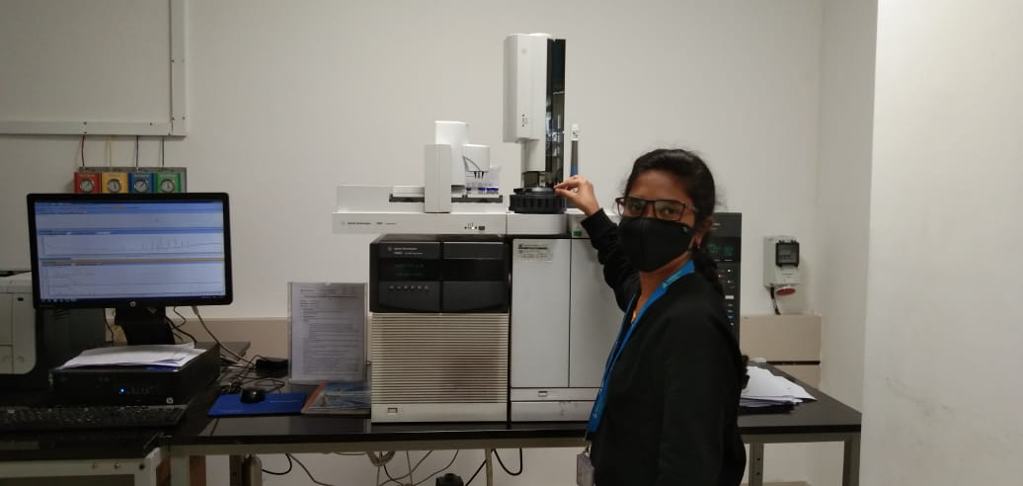
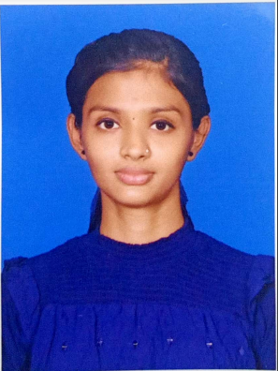
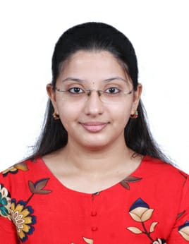
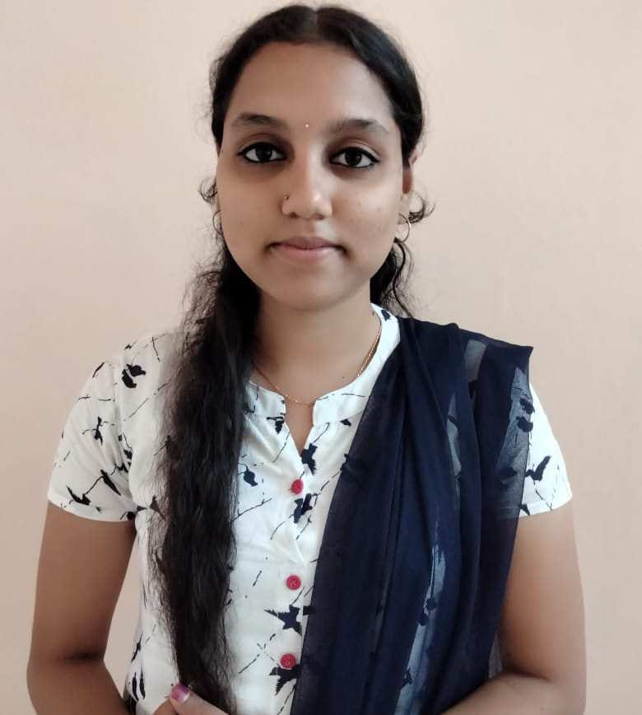
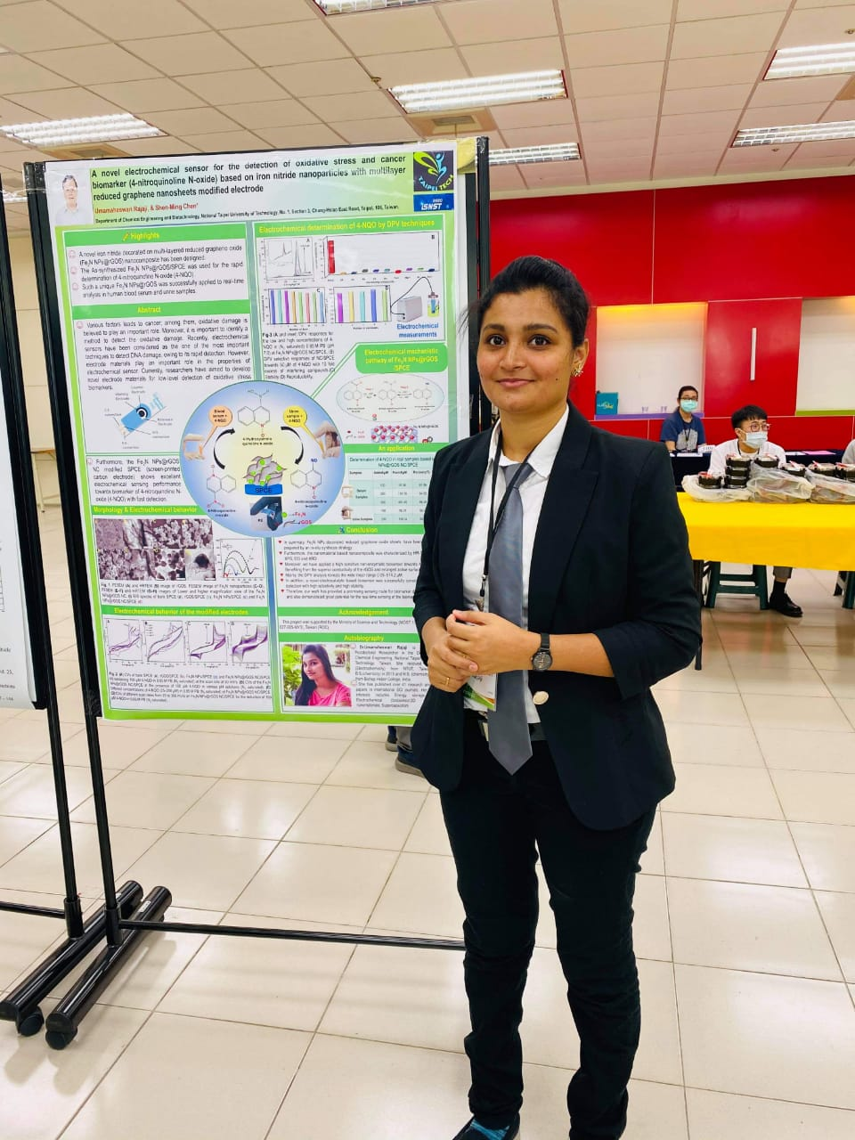
Placements
No of Students placed- 22 (2017-22)
S.Preethi,
Typist,
Divisional office,
Thanjavur
A.Niranjana
Sanitary inspector
Greater Chennai Corporation
Chennai
B.Lavanya
Junior Executive
Material testing laboratory
TUV-Rheinland Asia
Bangalore
Training by Placement division
S.A. Suganthi
Junior patent analyst
Molecular connections Bangalore
B.Sambavee
Process Enabler
TCS
Chennai
R. Uma Maheshwari
Postdoctoral faculty
Ming Chi University
Taiwan
Koli Harshada Sanjay,
In-plant - Training - HAPP
Tiruchirappalli

Slide 13
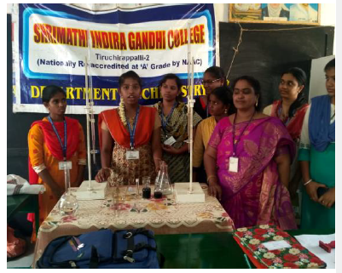
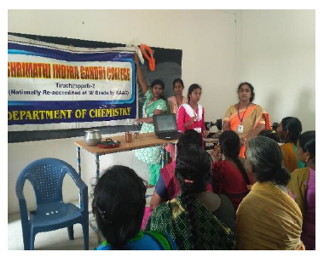
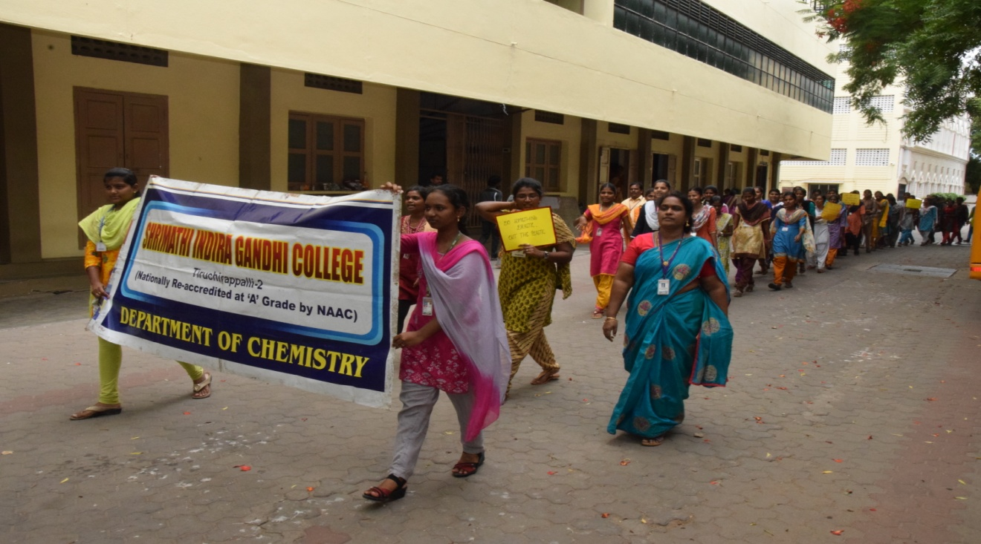
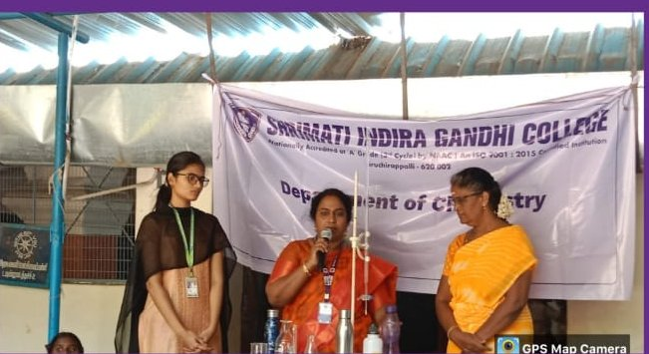
Out Reach Programmes
Water testing & analysis -Thayanur
Dynamic Approaches on Metal Utensils - Pallakkadu
Rally on Plastic free zone
Water testing at Townhall School - Trichy

Slide 14
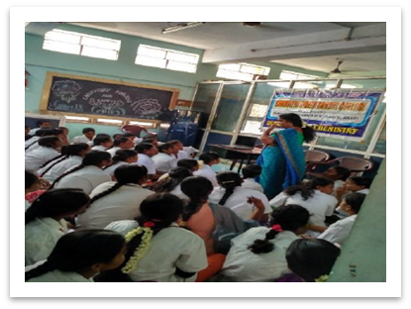
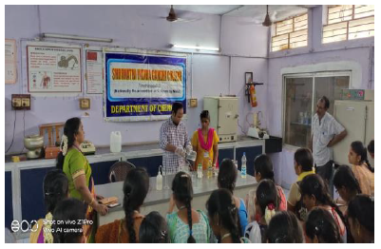
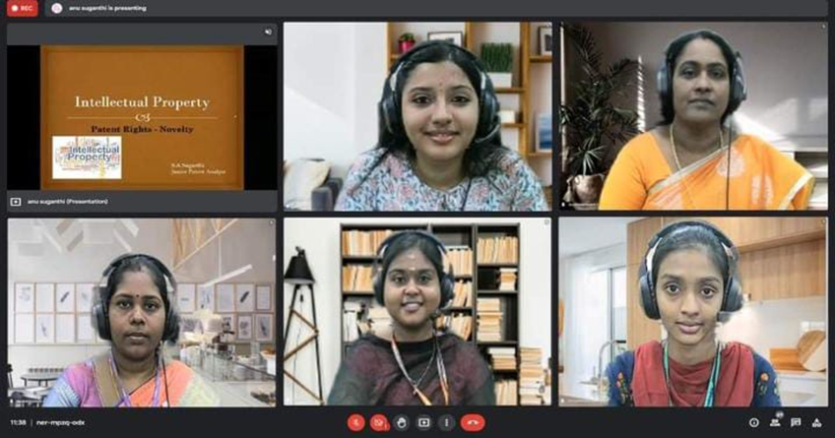
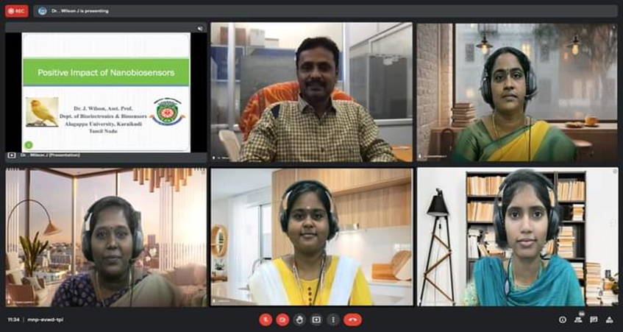
Workshops & Webinars
Cleansing Agents
Laboratory Hygiene and Safety
Novelty of Patent rights
Positive Impacts of Nanobiosensor

Slide 15
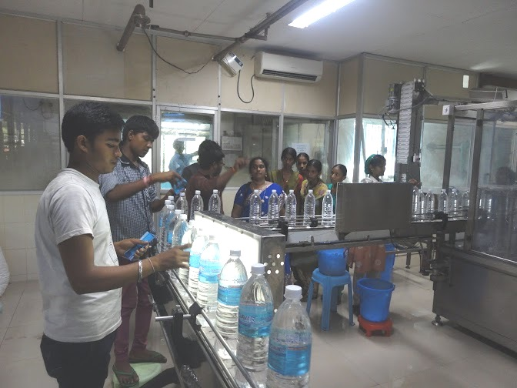
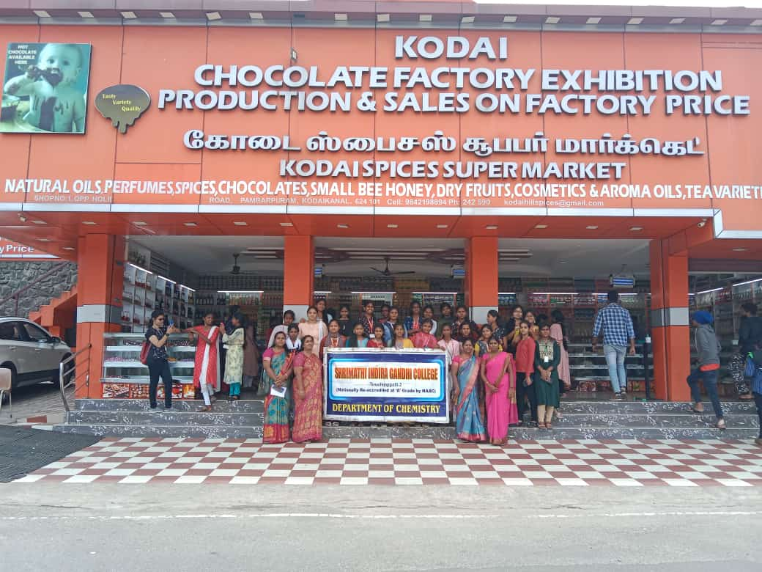
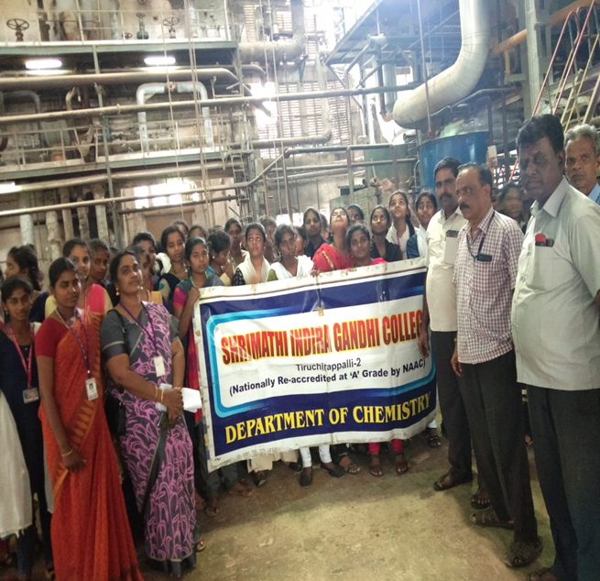
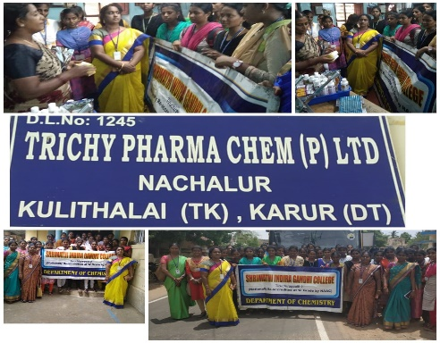
Industrial Visits
Pure and Pure Aqua food- Trichy
Kodai Chocolate factory
Kallakurichi Sugar factory
Trichy Pharma Chem

Slide 16
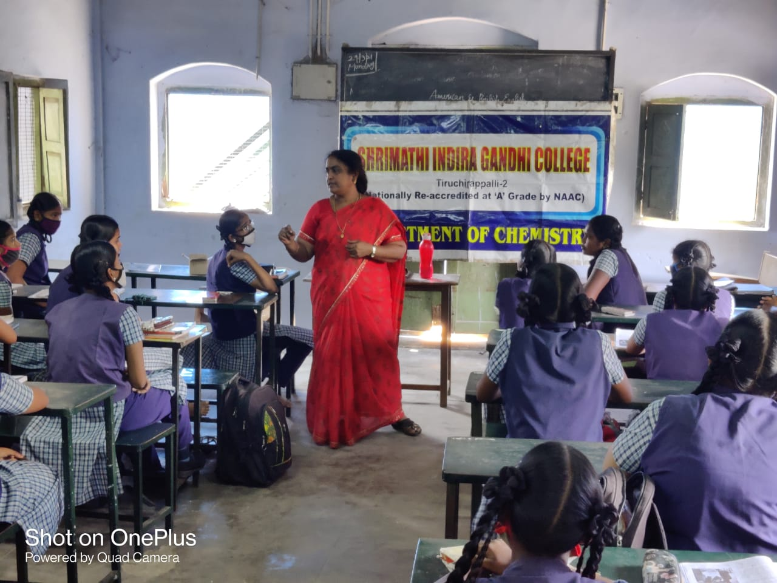
Best Practices
Promotion of Green Laboratory Techniques through Microscale experiments
Awareness programmes / workshops for school students
Chemical Wastes neutralized before disposal

Slide 17
SWOC Ananlysis
STRENGTH
Qualified and Experienced Faculties
Produced More Number of Rank Holders
WEAKNESS
Slow growth in the areas of consultancy, community engagement and student progression
Difficulty in establishing strong connections with local industries for research collaborations and internships
Capitalizing on the growing interest in STEM (Science, Technology, Engineering, and Mathematics) fields,
Pursuing research grants from government agencies and private organizations to enhance research capabilities.
OPPORTUNITIES
CHALLENGES
To Create awareness on Research & Development among the students.
To Develop the students as entrepreneur in Industries

Slide 18
Future Plan
Introducing M.Sc Chemistry
Increasing MOUs with industrial entities
Introducing industry-demanding courses like Textile chemistry, cosmetic chemistry, etc

Slide 19
Thank You

